Slide 1
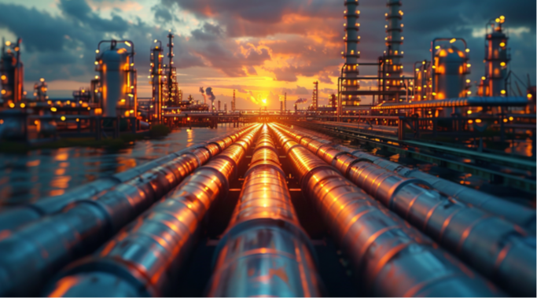

Absolute Impact 2024
Carbon Tracker Initiative
Olivia Bisel & Rich Collett-White - Oil, Gas & Mining
December 2024
Report Download
Notes:
THANK YOU FOR INVITING US TO CHAT TO YOU ALL TODAY & FOR TAKING THE TIME OUT OF YOUR DAY
BY WAY OF INTRODUCTION MY NAME IS SIMON PERHAM, I AM PART OF THE OUTREACH TEAM & PRIOR TO CARBON TRACKER SPENT 23 YRS IN EQUITY RESEARCH SALES & CAPITAL MARKETS IN THE CITY.

Slide 2
Carbon Tracker
Notes:
Carbon Tracker is A MISSION DRIVEN NOT FOR PROFIT THINK TANK
90% of what we do is behind closed doors, such as this one. Therefore 10% of what we do is 100% of our media profile.

Slide 3
Research

Slide 4
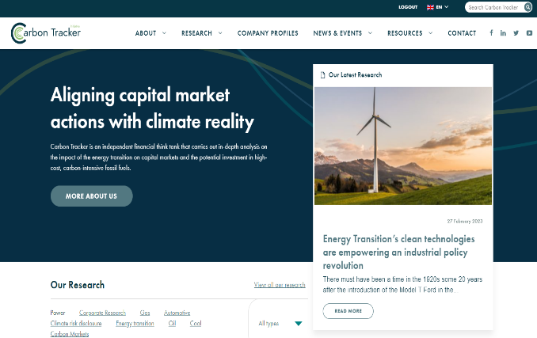


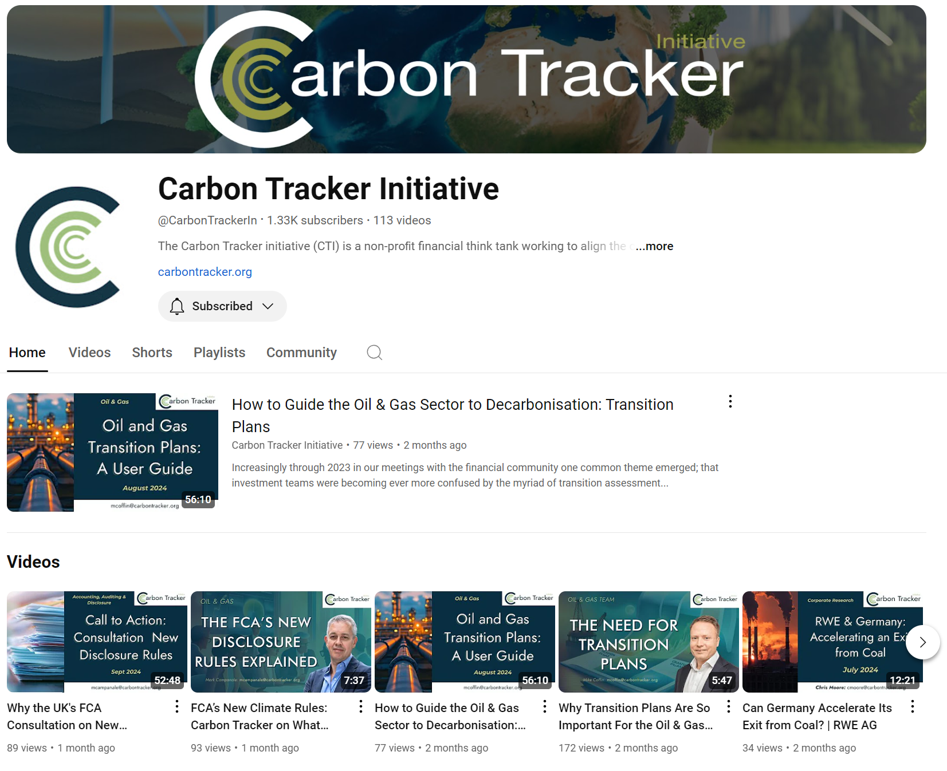
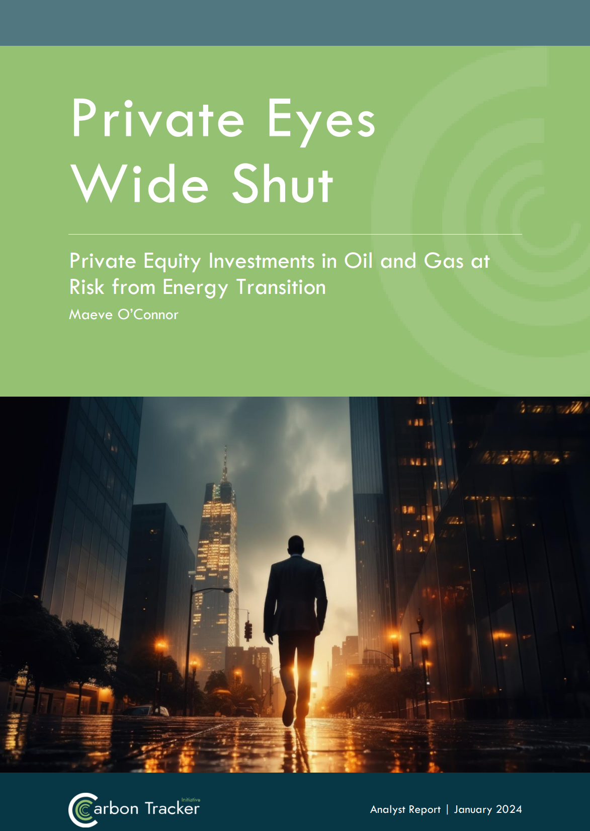
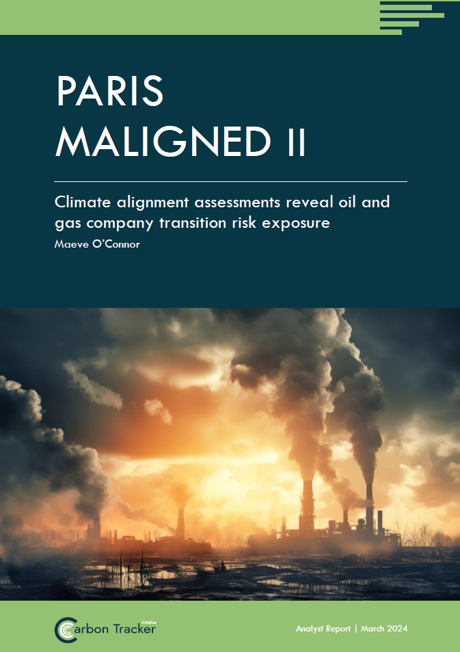
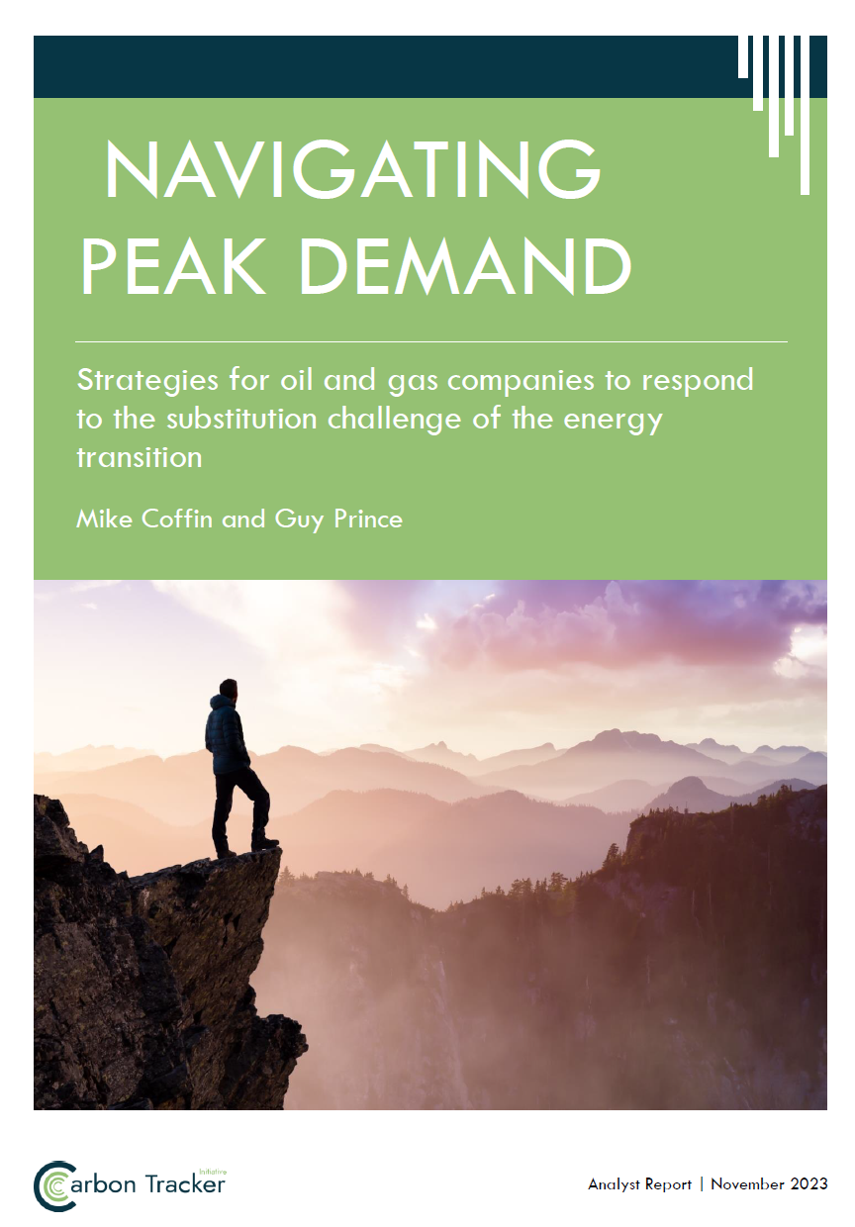

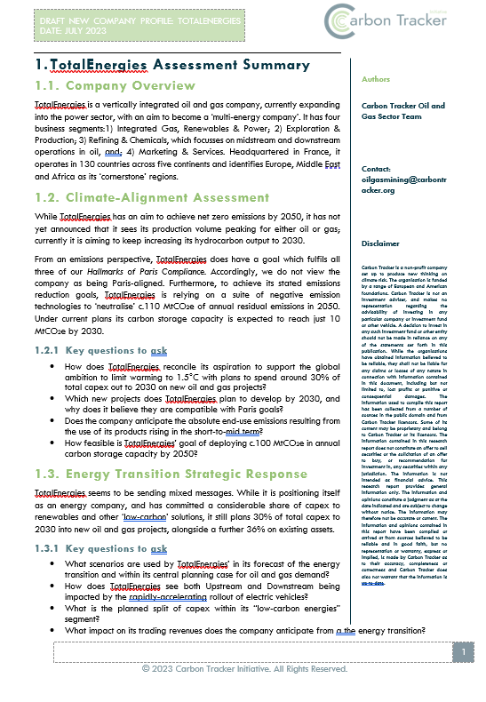
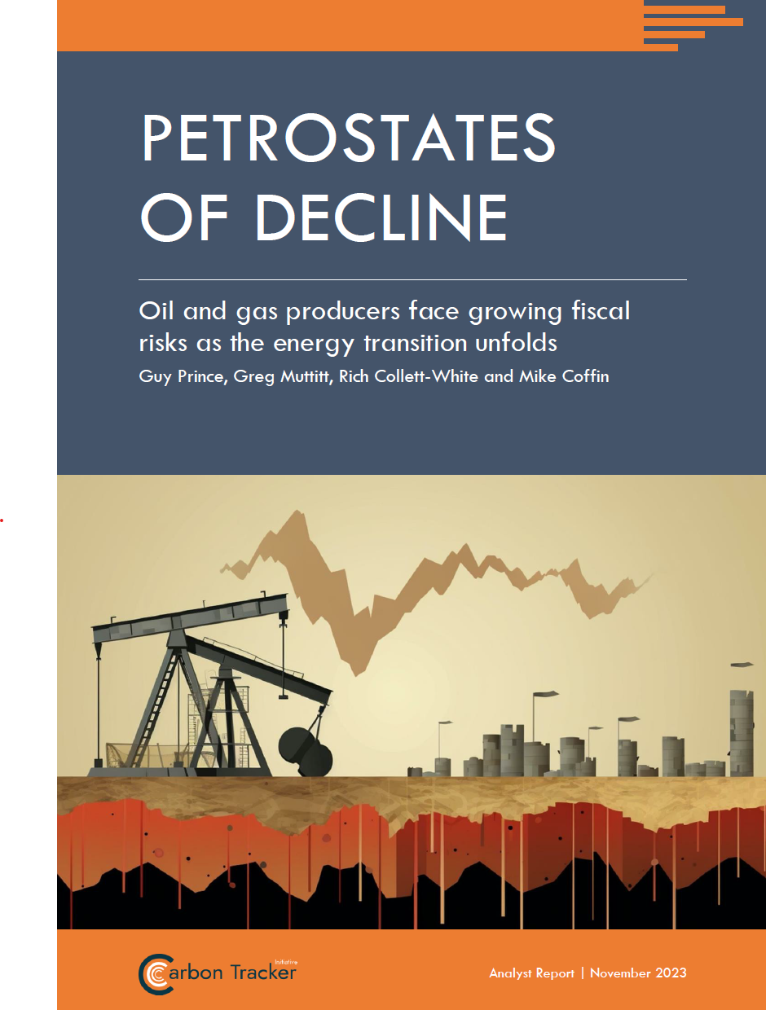

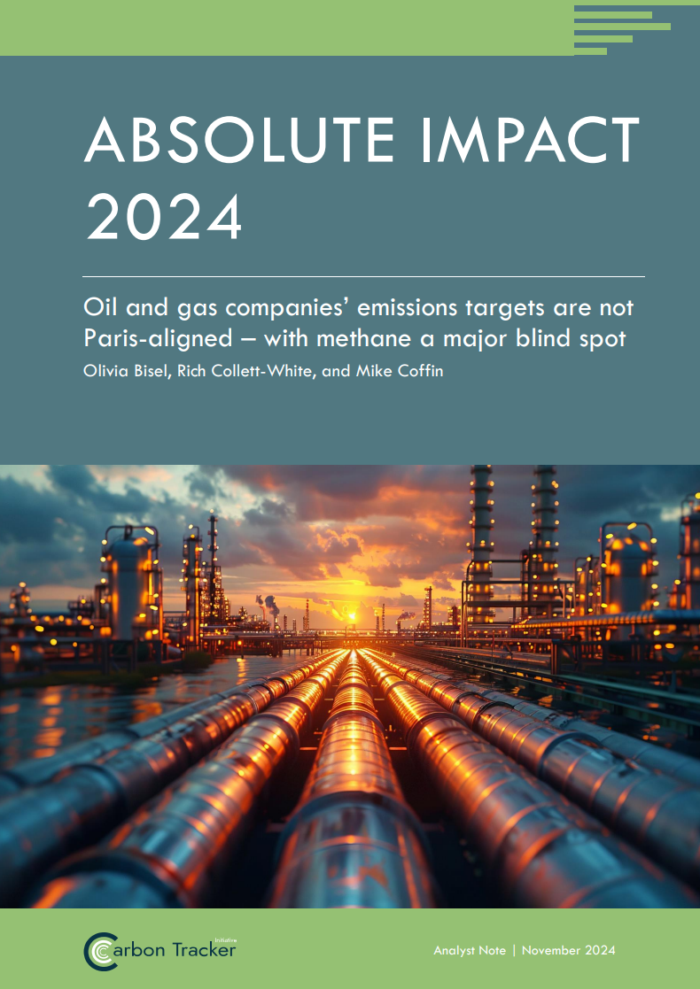

www.carbontracker.org
www.carbontracker.org
3rd Party Platforms
YouTube
Notes:
Carbon Tracker is A MISSION DRIVEN Independent NOT FOR PROFIT THINK TANK
Our mission is to accelerate the energy transition by positively influencing the financial markets.
We do this by writing economic fact-based research converting climate science into financial risk & reward.
ALL OF OUR RESEARCH IS FREE TO DOWNLOAD FROM OUR WEBSITE
OR FROM A VARIETY OF 3RD-PARTY PLATFORMS

Slide 5


Olivia Bisel
Associate Analysts & Lead Author – Carbon Tracker
Olivia joined Carbon Tracker’s Oil, Gas & Mining Team as an Associate Analyst in 2023.
Previously, Olivia managed a project on climate-related financial risk for the University of Oxford. She has also advised private equity, growth equity, and private credit investors as an ESG management consultant at Malk Partners.
Olivia holds an MSc in Sustainability, Enterprise, & the Environment from Oxford University & a BS in International Affairs from Georgetown University.
Rich Collett-White
Analyst & Co-Author – Carbon Tracker
Rich joined Carbon Tracker in October 2023 as an analyst in the Oil, Gas & Mining team.
Prior to this, he worked as an editor & reporter at DeSmog, investigating misinformation, greenwashing and the influence of vested interests on climate and energy policy.
Rich holds an MSc in environmental & energy economics from UCL & a BA in French & Russian from Oxford University.

Slide 6

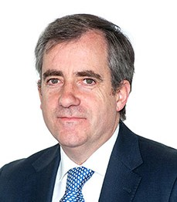
Luis Cabra
EMD Energy Transition Tech, Institutional Affairs & Deputy CEO Repsol
Luis is executive managing director of Energy Transition, Technology, Institutional Affairs, & deputy CEO. He is a member of Repsol's Executive Committee.
His responsibilities include core areas for the development & implementation of the company's energy transition strategy, such as Technology, Digitalization, Engineering, & Sustainability.
He has held leadership roles in several Intl Assocs, including as chair of the Automotive Fuels Action Group & a member of the EU Research Advisory Board. He holds a PhD in Chemical Engineering.
Antonio Lorenzo
Chief Financial Officer - Repsol
Antonio is currently Repsol's chief financial officer (CFO) & a member of the Executive Committee.
His role involves optimizing the corporate development and financial-economic structure of the Company. His responsibilities also encompass the design of the strategy, relations with analysts & investors, & reporting.
Antonio joined Repsol in 1990. From 2008 on, he has held executive positions in the areas of Planning & Control, Risk & Regulatory Mgmt. & served as the executive managing director of Strategy, Control, & Resources until July 2018.

Slide 7


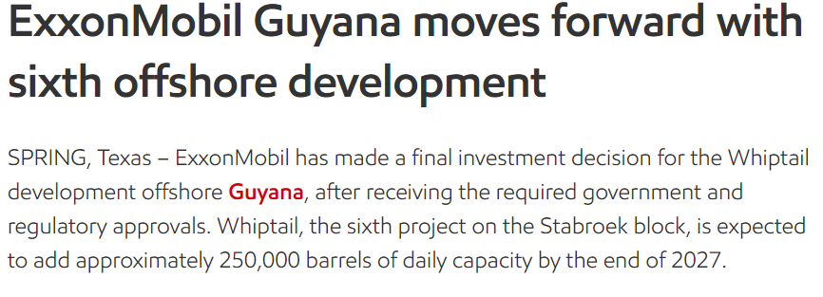
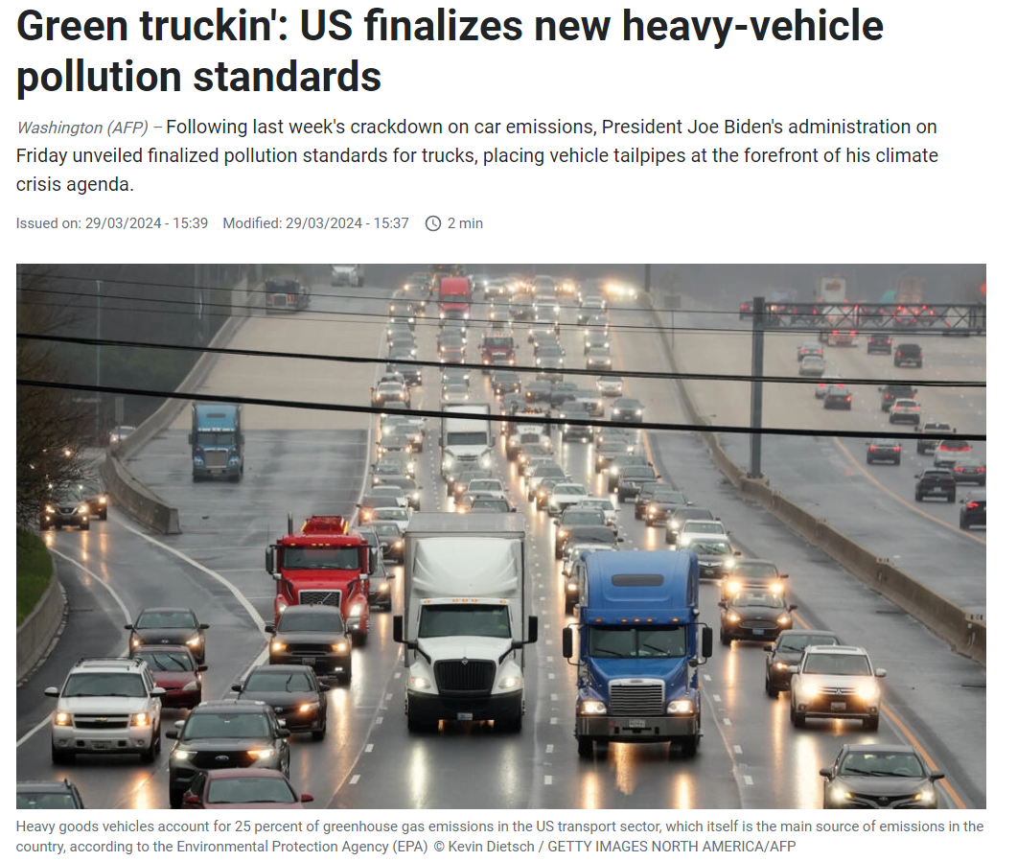
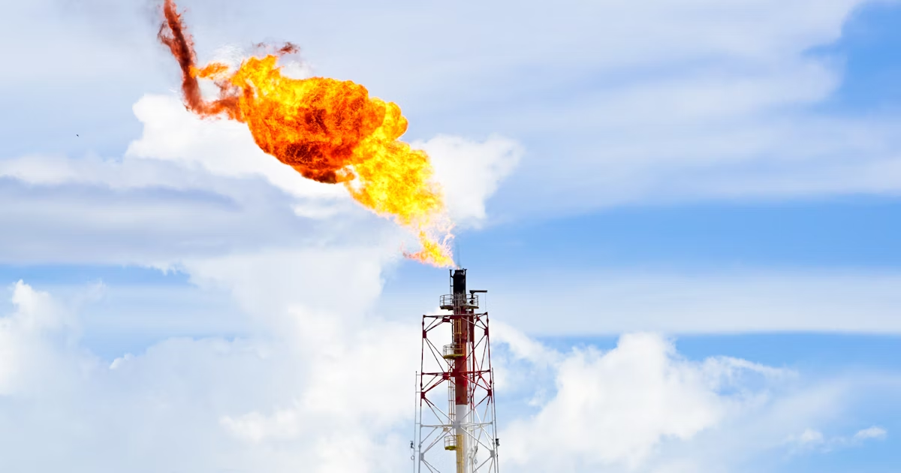
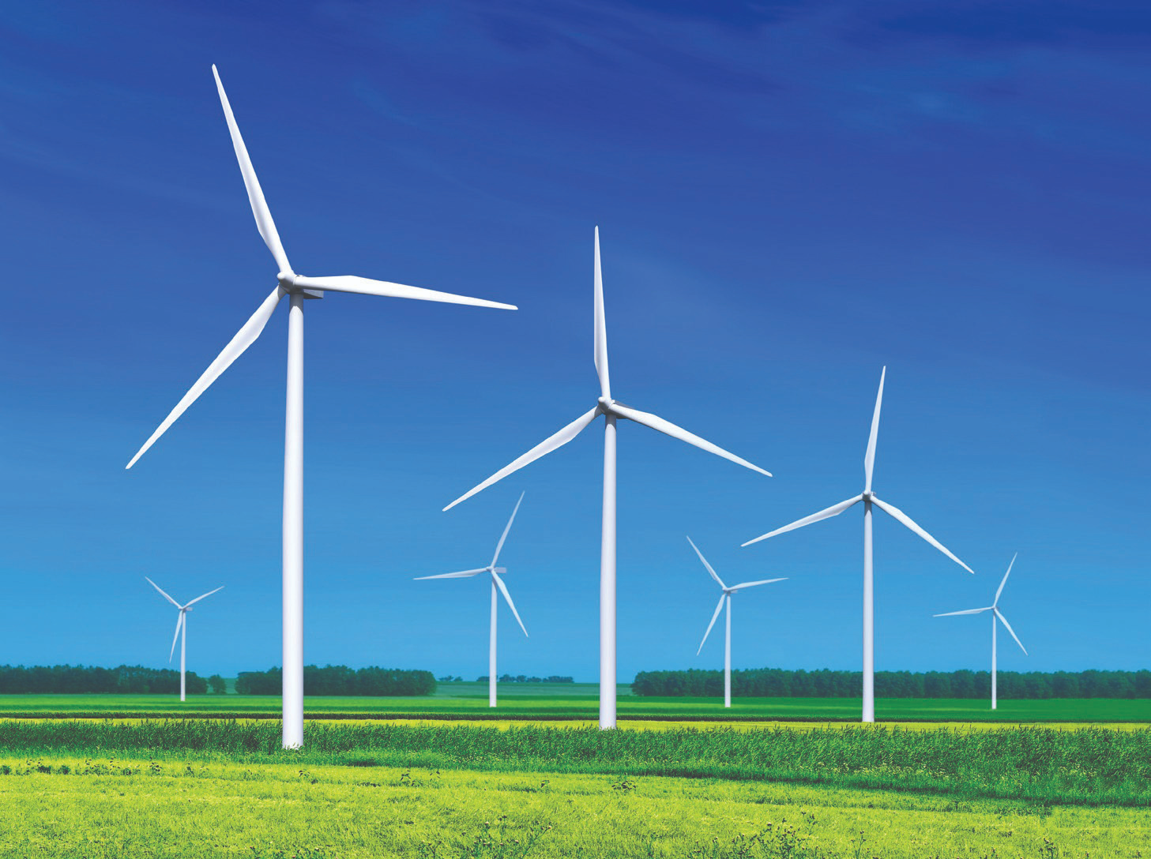
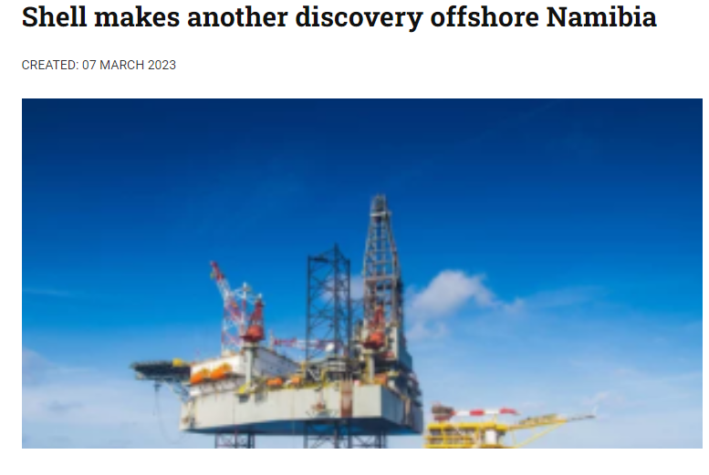

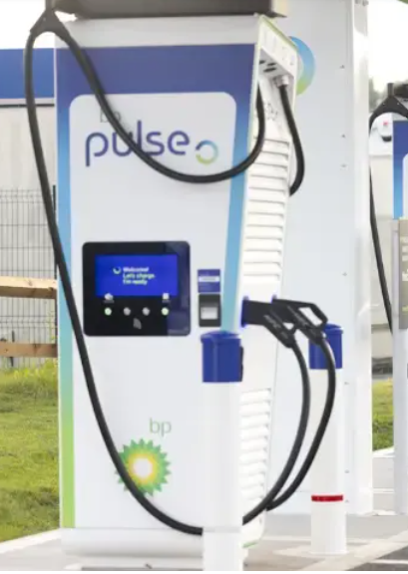
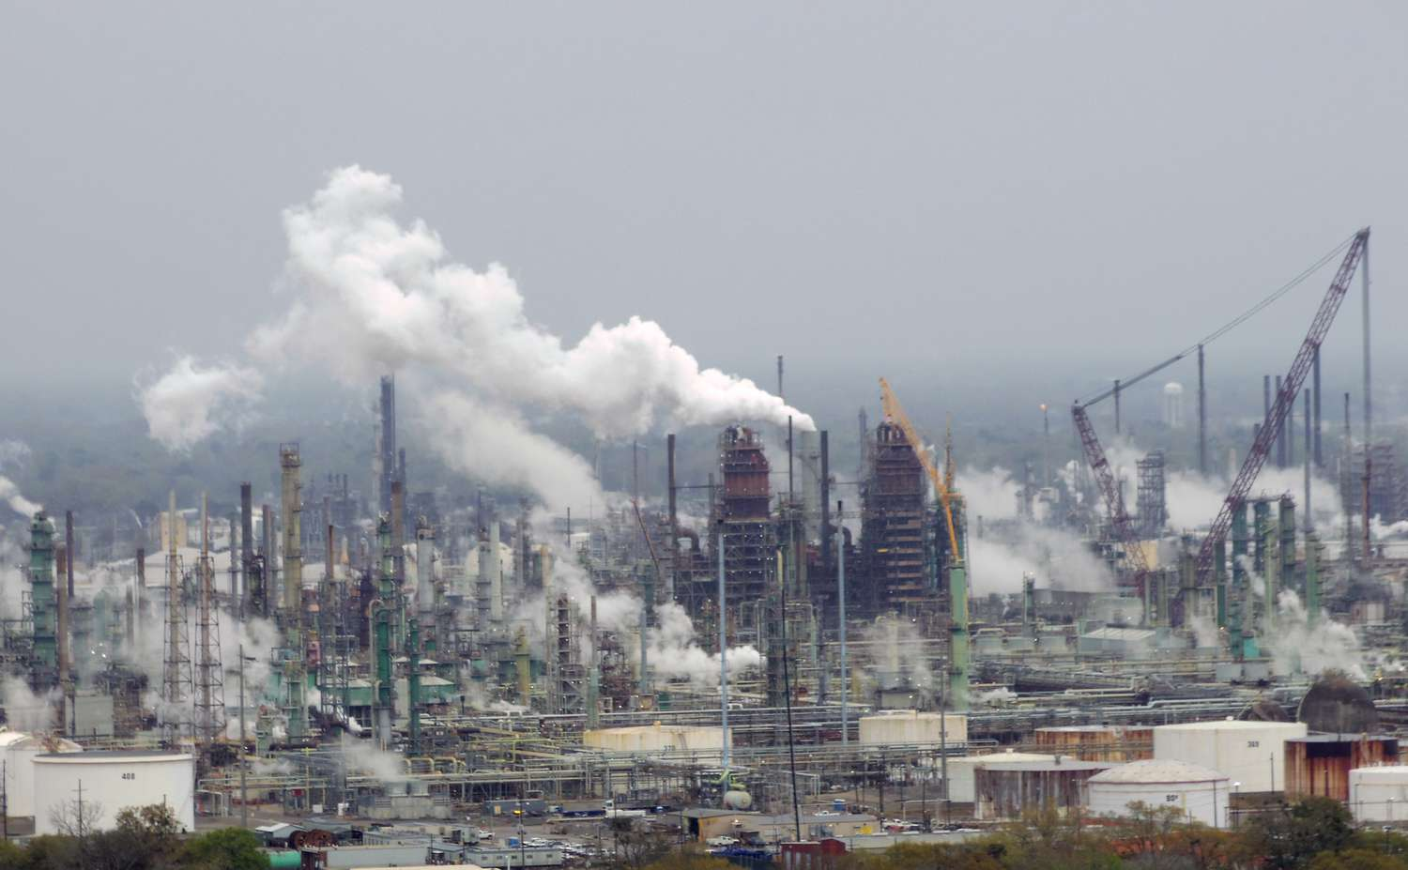
Use emissions targets to assess transition plans through two lenses
Reduction in climate impact of corporate activities
Exposure to climate-related financial risks / opportunities
AND
Key element of Paris alignment assessment
Highly relevant for investors/FIs with Net Zero goals
Targets a proxy for long-term production plans
Relevant for all investors
Notes:
When we think about emissions targets, we are really considering them through a dual lens.
Paris-alignment assessment
First, of course, we’re interested in targets as providing one view on Paris alignment, helping companies maintain a social license to operate and demonstrating how companies are addressing their climate impact.
Transition risk exposure
But beyond that, they can also provide insights into risk exposure. If we view emissions targets as a proxy for future production plans, they can provide a signal of long-term company exposure to energy transition risk, such as risk of substitution of demand for oil and gas. This translates to financial risk for investors as well, in the form of lower returns.
Understanding corporate action on methane enables assessment of exposure to regulatory risks – e.g. cargoes into the EU.

Slide 8




Analysis assesses targets of 30 of the largest oil & gas companies
Appropriate framing?
Trends over time?
Relative ranking vs. peers?
Credibility of emissions reduction strategy?
Notes:
Appropriate framing: Do the targets link through to a finite global carbon budget? Are they covering all the business activities of the company?
Trends: Are companies improving, stalling, or regressing in terms of the ambition level of their emissions targets compared to previous years? Have updates to emissions targets actually moved the needle on alignment with Paris goals?
How do companies stack up against each other?
Credibility: Beyond how ambitious the target is, is the company’s strategy for how they will achieve that target and deliver the actual emissions reductions credible, or does it rely on approaches that carry risk of being uncertain, unproven, or commercially non-viable?
Are strategies for emissions reductions overly-reliant on asset sales, or deployment of CCS?

Slide 9
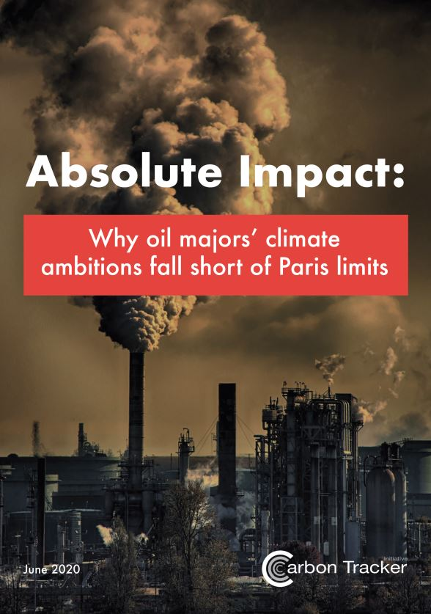
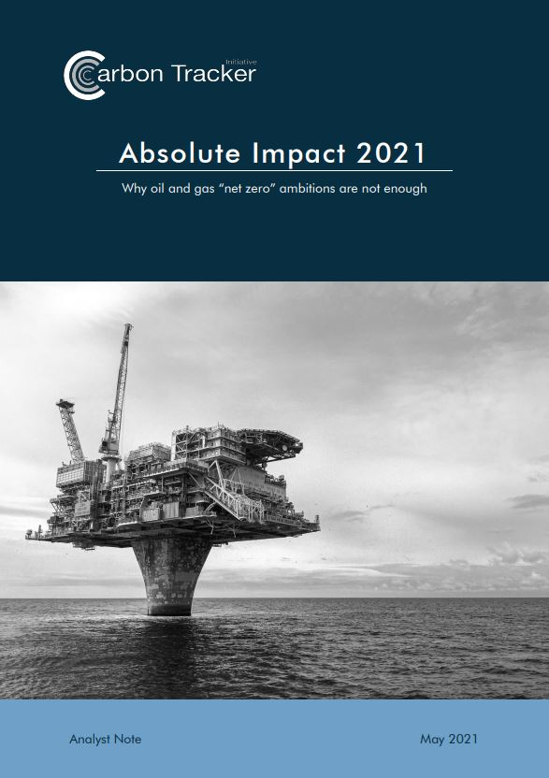
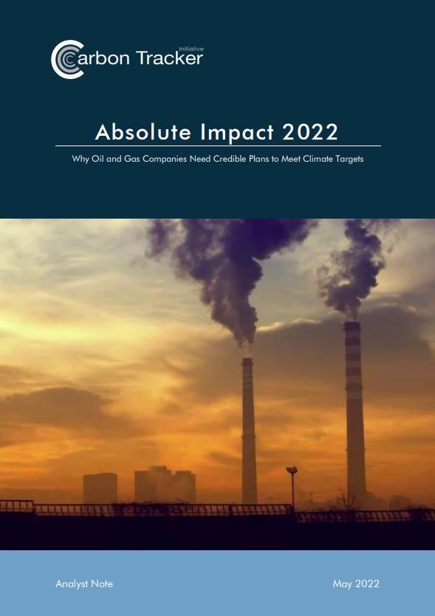
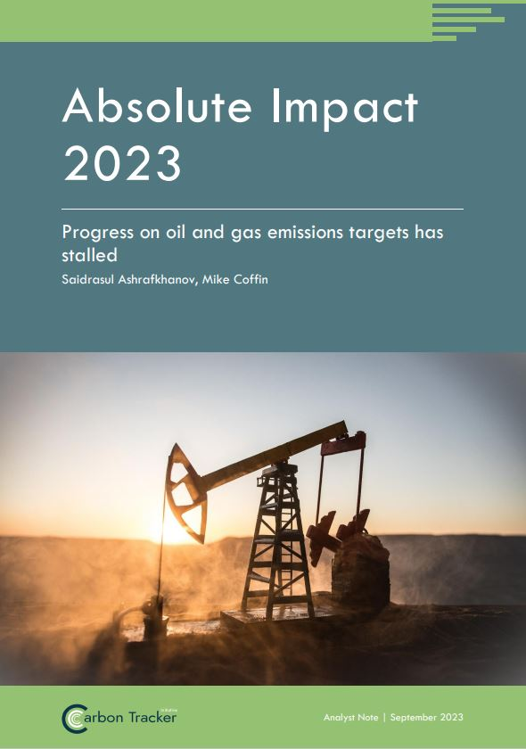

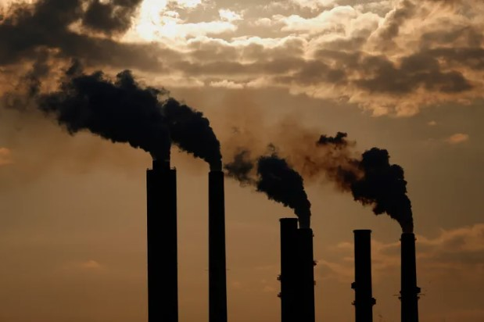





Evolution of Absolute Impact series since 2020
Methane-specific targets
5 wholly state-owned national oil companies (NOCs)
New this year
Notes:
Fifth iteration of our Absolute Impact report –> enables us to analyse how emissions targets are changing over time as
companies evolve on climate and energy transition
stakeholders press companies on these matters
the energy transition accelerates.

Slide 10
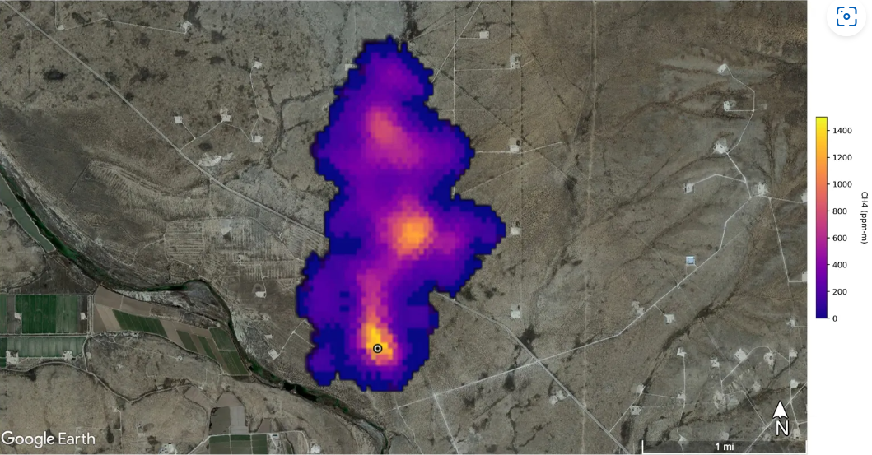
Why include methane?
Near-term methane reductions critical to limit warming
Increased expectations from regulators and policymakers
Increased corporate commitments
Methane-specific targets often distinct from overall GHG targets (CO₂-eq)
Notes:
Widely recognised need for significant near-term methane reductions to keep Paris Agreement goals within reach, given its potency as a GHG (85x CO2 over first 20 years after release)
Momentum around this has been rapidly building, globally – Global Methane Pledge etc
Viability of methane reduction measures within the oil/gas sector = greater expectations from policymakers, green investors, civil society etc.
Need for methane-specific targets in order to assess ambition on this distinct, more pressing issue, disaggregated from CO2

Slide 11
To potentially be considered Paris-aligned, targets must satisfy each of our four Hallmarks of Paris-Aligned Emissions Targets:
Overall GHGs
Methane-Specific
Hallmark 1 | Hallmark 2 |  | Hallmark 3
Hallmark 1 | Hallmark 2 |  | Hallmark 3 |  | Hallmark 4
Scope 3 emissions | Scope 1,2,3 net-zero | 2030 absolute goal | Full equity share | 3rd party crude | Near-zero by 2030 | Full equity share | Midstream gas
Net-zero
Non-operated
assets
Operated
assets
3rd party crude
Baseline
Medium-term
2050
Notes:
Hallmarks:
1.Include full lifecycle emissions from both operational (scopes 1 and 2) and end-use (scope 3) emissions
2.Be bounded by finite limits, including interim milestones set on an absolute basis
3.Cover emissions from a company’s owned production and global product sales on a full equity share basis, including downstream product sales from 3rd-party crude
4. Aim for near-zero methane emissions for both operated and non-operated assets, including Midstream gas where applicable

Slide 12
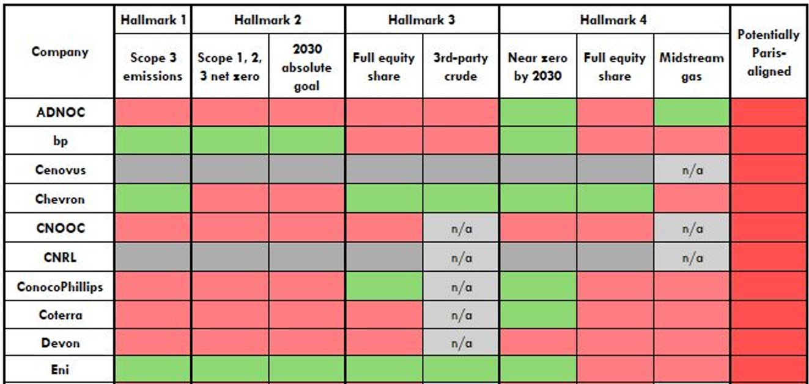
No company has potentially Paris-aligned emissions targets
Overall GHGs
Methane-Specific
Excerpt of Table 2 in Absolute Impact 2024
Notes:
THE IMAGE IS JUST AN EXCERPT
-No companies have Paris-aligned emissions targets
i.e., targets do not sufficiently link to finite GHG budgets under the Paris Agreement
-Progress on overall GHG targets has stalled in the past year
Despite updates to targets by certain companies such as Shell, this hasn’t meaningfully changed the picture on alignment of emissions targets with Paris goals
Nearly all companies demonstrate room for improvement in terms of ensuring their overarching GHG target covers all business activities – including all assets in which they have an equity stake and downstream products using third-party crude.
Eni is the only company that meets Hallmarks 1, 2, and 3 regarding overall GHG targets, but it falls short on the coverage of its methane goals.
-More broadly, no company fully meets our new hallmark on methane (which will be discussed at greater depth by Rich in a minute).

Slide 13
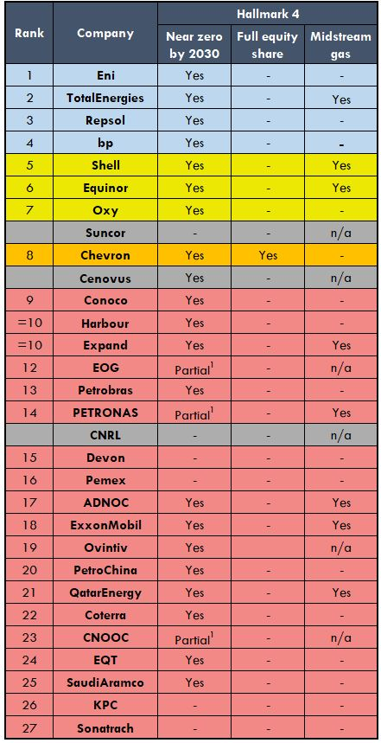
The analysis enables identification of leaders and laggards
Overall GHG targets
Companies assessed in 2023 rank similarly
NOC entrants rank poorly
Methane-specific
“Near-zero” methane targets limited to operated assets
Some NOCs and North American companies not even aiming for “near-zero” methane
Midstream gas assets often overlooked
n.b. Companies ranked across all Hallmarks; only Hallmark 4 shown in table
= new to 2024 company universe
Notes:
THE IMAGE IS JUST AN EXCERPT showing Hallmark 4 – full table in the analyst note
Key GHG points:
-European majors continue to rank better than others, though still fall short in that their targets do not cover all full lifecycle emissions across all relevant areas of their business.
-In contrast, targets of NOCs rank particularly poorly – no NOCs have a scope 3 target, neglecting the vast majority of lifecycle emissions.
Key methane points to make:
Majority of the largest oil/gas producers have coalesced around near-zero methane by 2030, in line with expert recommendations
But only Chevron has an equity-based target, ie including non-operated assets
This means almost all companies are overlooking a significant amount of their production, particularly in the case of European/US majors
In many cases, this production (through joint ventures) is happening in countries with high methane emissions, eg Algeria, Nigeria
Additionally, many companies have not set targets covering their Midstream gas assets (ie pipelines and LNG facilities), despite contribution of this segment to methane emissions
No companies appear to have policies in place to only use Midstream gas operators with strong methane performance
Lack of standardisation around methane intensity targets: companies use different numerators and denominators, making benchmarking nigh-on impossible
Use of gas production as denominator skews in favour of high gas producers
“Near-zero” is also defined differently by companies. Most have coalesced around 0.2% of marketed gas, but some are much more ambitious – eg EQT’s 0.02%

Slide 14
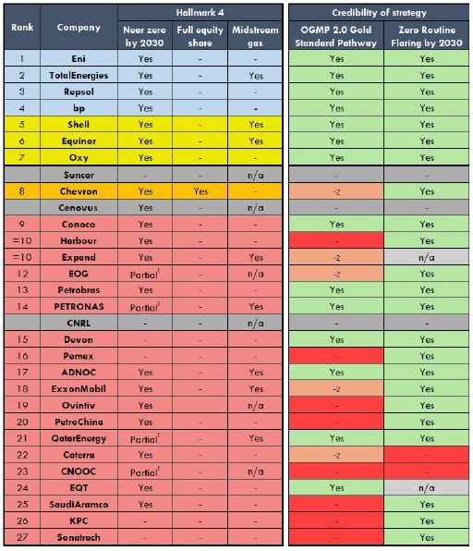
The analysis assesses the credibility of methane reduction plans
OGMP 2.0 Gold Standard Pathway
  c.50% of companies on OGMP 2.0 Gold Standard pathway
  No companies directly measuring all assets yet
Commitment to zero routine flaring by 2030
  Most companies aiming for zero routine flaring, although with limitations
= new to 2024 company universe
Notes:
Key points:
Independent studies consistently show significant underreporting of methane emissions by oil/gas industry, owing to use of crude/outdated emission factors rather than direct, independently-verified measurement
UN-led OGMP 2.0 trying to fix this problem, and many companies have now signed up
Growing number are assessed as being on Gold Standard pathway (particularly European/US producers, plus some NOCs)
GS pathway indicates credible strategy to directly measure the methane emissions of all assets (both operated and non-operated)
But no companies have yet achieved this, so targets should be viewed with scepticism for now
Another (limited) indicator of credibility is a company’s approach to routine flaring
This is an easily fixable source of emissions – the lowest of low-hanging fruit – and most major oil producers have now committed to eliminating it by 2030
But this is very much a first step, and there are significant limitations
“Routine” flaring can in some cases account for small proportion of total flaring (so emphasis should be on eliminating all non-emergency flaring)
Venting is much bigger problem than flaring

Slide 15


Analysis of emissions targets complements other metrics
 | Climate Impact | Transition Risk
Emissions targets | Framing of targets Credibility of emissions reduction plans | Proxy for production plans Cost of emissions reductions efforts
Investment (capex) and production | Upstream investment into new projects | Exploration & development plans O&G capex (new vs. maintenance)
Executive remuneration | Incentives to reduce FF developments | Incentives to prioritise value
Lobbying practices | Paris alignment of lobbying activities | n/a
Corporate demand forecast | Consistent with Paris-aligned scenario? | Pace of energy transition the company is planning for
Commodity price forecast | Consistent with Paris-aligned scenario? | Consistent with demand forecast and impairment testing?
Climate Impact
Notes:
Climate impact side—a holistic assessment of Paris alignment should extend beyond emission targets to also consider metrics such as:
Whether companies are planning for oil and gas production declines, with limited investment into new conventional projects
Whether companies are setting executive remuneration in a way that incentivizes emissions reductions
Whether companies are actively lobbying in a manner that impedes global action on climate
Remuneration: Do personal incentives support strategy?
Energy transition risk side –
Looking at least-cost analysis, what risk do planned production and investment pose to the company’s future profits and net present value? Are new developments viable?
Climate risk disclosure: are companies providing clear and accurate disclosures of their climate-related risks, such as assumptions on commodity prices as the energy transition unfolds?
These aspects are covered in other CTI reports and company profiles.

Slide 16

Key Takeaways
Methane a particular blind spot for all
NOCs generally have very weak targets and lag corporates
Plans to achieve targets often lack credibility
Emissions targets can indicate strategic production plans
Analysis fits within investment screening processes & supports corporate engagement
Absolute Impact Report
Company Profiles
oilandgas@carbontracker.org
Notes:
For financial institutions concerned with climate impact, compare analysis against investment or lending eligibility criteria and any climate impact claims; from a risk perspective, consider climate-related risk within investment/lending decision-making. Where corporate emissions targets are unsatisfactory from a climate or risk perspective, take actions such as investor meetings/letters, shareholder resolutions, voting on board members, altering (re)financing decisions, and/or exiting within defined timeframe.
On the policy and regulatory side, ensure that corporate emissions rules are aligned with national commitments, and that there are clear disclosure requirements for climate-related risk.
Happy to answer any further comments/questions not covered in the Q&A via email.
Report linked in final slide contains the full analysis.

Slide 17
Disclaimer

Slide 18
Appendix
Full Ranking Table
= new to 2024 company universe

