Slide 1
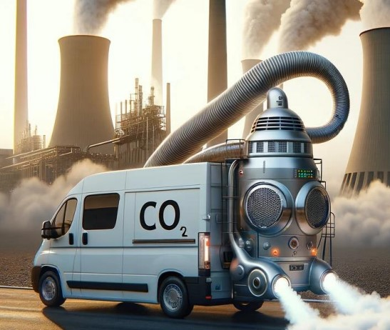
CCUS - Curb Your Enthusiasm Bridging the gap between the UK’s CCUS targets & reality
Carbon Tracker Initiative
Lorenzo Sani – Analyst, Power & Utilities lsani@carbontracker.org

Slide 2
Carbon Tracker
Notes:
WHO IS CARBON TRACKER?
A MISSION DRIVEN NOT FOR PROFIT THINK TANK
OUR MISSION IS TO ACCELERATE THE ENERGY TRANSITION BY POSTIVELY INFLUENCING THE FINANCIAL MARKETS
WITH A VISION OF A FULLY DECARBONISED GLOBAL ECONOMY

Slide 3
Research
Notes:
WE DO THIS BY CONVERTING CLIMATE SCIENCE & ENERGY TRANSITION EVOLUTION INTO FINANCIAL RISK & REWARD
OUR RESEARCH IS SPLIT INTO 3 CORE SECTORS & IS CROSSCUT BY VARIOUS MORE FOCUSED INITIATIVES

Slide 4
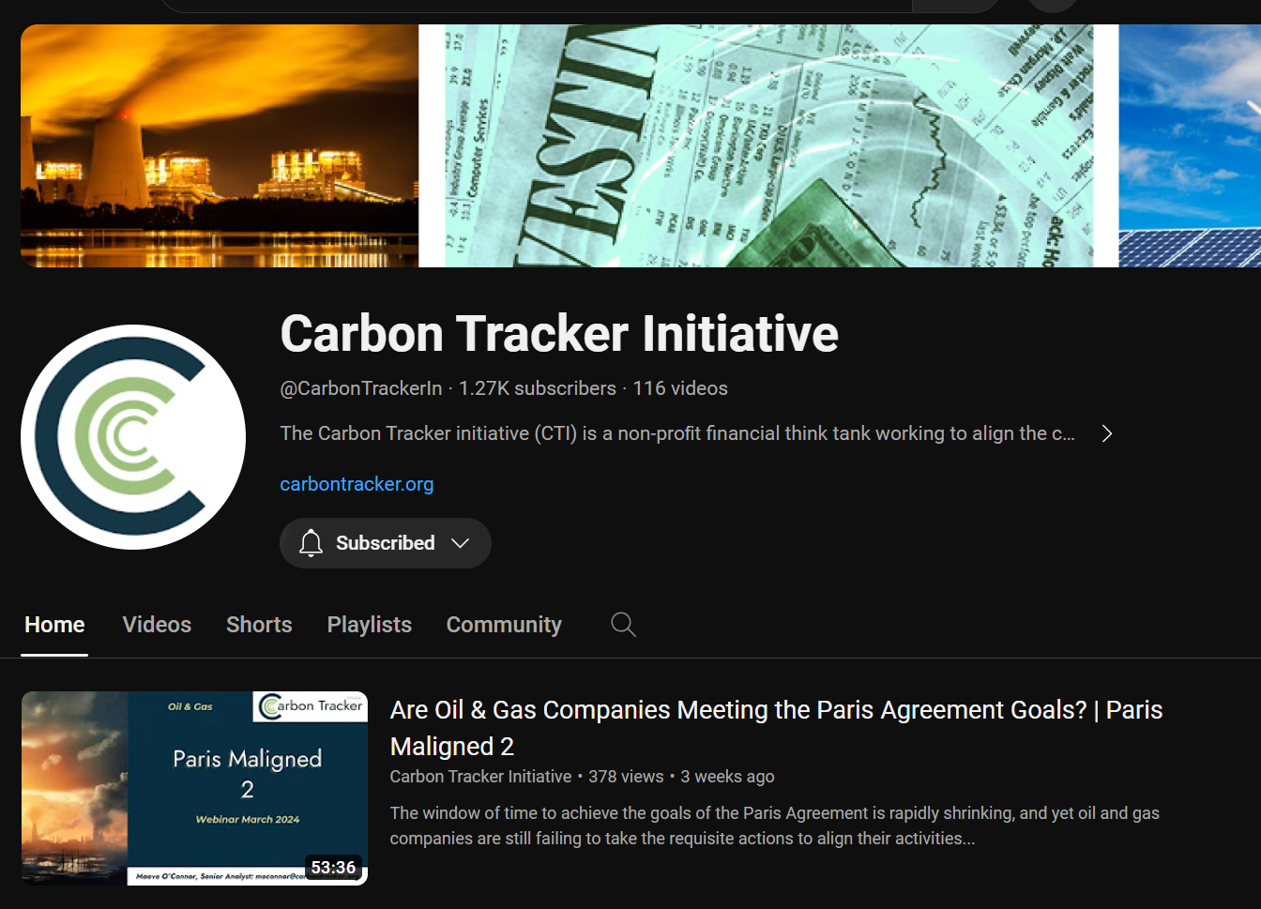
Where can you see it?
www.carbontracker.org
3rd Party Platforms
YouTube
Notes:
ALL OF OUR RESEARCH IS FREE TO DOWNLOAD FROM OUR WEBSITE
OR FROM A VARIETY OF THIRD PARTY PLATFORMS
YOU CAN ALSO LISTEN TO IT ON OUR YOUTUBE CHANNEL

Slide 5
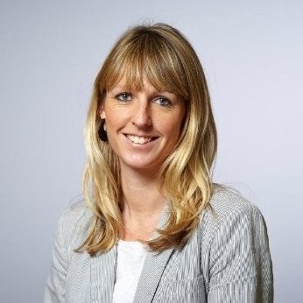
Olivia Powis
UK Director - Carbon Capture & Storage Association
Olivia works with the Chief Executive & CCSA Board on developing the UK strategy & work programme of the association
Before joining the CCSA, Olivia was a Senior Policy Manager at the National Infrastructure Commission
Carl Greenfield
Energy Analyst - IEA
Carl leads the policy & engagement work on the carbon capture, utilisation and storage (CCUS) team
Prior to joining the IEA, Carl served as Director of Energy and Environment at a policy consulting firm in Washington, DC
Karl Smyth
Director External Affairs & Strategic Policy - enfinium
Karl leads enfinium’s engagement & communication with Government, regulators & value chain partners
Prior to enfinium, Karl, was Group Head of Bioenergy CCS Strategy & Engagement as well as Policy & Government Relations at Drax Group plc
Notes:
Olivia Povis
Is UK Director - Carbon Capture & Storage Association where she works on developing the UK strategy & work programme of the association
Prior to CCSA, Olivia was at the National Infrastructure Commission
Carl Greenfield
Is an Energy Analyst at the IEA where leads the policy & engagement work on the carbon capture, utilisation and storage (CCUS) team
Prior to the IEA Carl was at a policy consulting firm in Washington, DC
Karl Smyth
Is Director External Affairs & Strategic Policy at enfinium where he leads enfinium’s engagement & communication with Government, regulators & value chain partners
Prior to enfinium, Karl, was at Drax Group plc

Slide 6
Agenda
Lorenzo Sani
Analyst, Power & Utilities
The Global Challenge
The UK’s CCUS strategy
Risk assessment by sector
Carbon Markets
The need for new Targets
Carbon Capture Utilisation and Storage
Curb Your Enthusiasm
Free to download on the Carbon Tracker website: www.carbontracker.org
Curb Your Enthusiasm - Carbon Tracker Initiative
Notes:
Thank you Hannah for the excellent introduction
Good morning everyone and welcome to this webinar!
My name is Lorenzo Sani and I’m an analyst in Carbon Tracker’s Power and Utilities Team
Today I’m excited to present to you the main findings of our report “Curb your enthusiasm - Bridging the gap between the UK’s CCUS targets and reality”
In a very condensed form, the aim of this report is to explore what’s the role of CCUS in the UK’s transition to net zero.
In the coming slides I’ll try to answer this question by presenting the global challenge to then focus on the UK’s CCUS strategy. Next, I’ll present our risk assessment results followed by an analysis of the role of carbon markets and concluding on the need for new targets.

Slide 7
The Global Challenge
8% emission reductions from CCUS in IEA’s Net Zero Emissions by 2050
20x growth by 2030
-30% reduced target since 2021
Ambition Gap
Source: Carbon Tracker 2024 – Curb your Enthusiasm |
Notes:
Let’s have a quick look at the challenge from a global perspective
Most other energy transition models agree that CCUS is a key tool in net zero scenarios
According to the IEA, CCUS should account for 8% of emission reduction in its Net Zero scenario
This would require a massive scale up of the technology, from the 50MtonCO2 (0.1% of global emissions) we have today to 1000 by 2030
Two worrying signs on the industry ability to deliver on this
1- the IEA in only 2 years reduced its ambition for CCUS by 30%
2- Nonetheless, There is still a very large ambition gap between what the industry is planning and what would be needed for NZE.
Will the industry be able to clae up or Should we update the models once more?

Slide 8
UK’s plan: High Ambition and De-risking
Ambition:
20-30 MtonCO2 capture by 2030
>50 MtonCO2 by 2035
Self-sustaining market
from 2035 towards 2050
Source: Carbon Tracker 2024 – Curb your Enthusiasm
Notes:
The UK has got a long history with CCS. the first ccs programs started almost 20 years ago, however, to date we still don’t have any project on the ground
UK has got the ambition of becoming a global leader in CCUS
The UK plans to create a CCUS sector in the 2030s with a target of at least 50Mton by 2035 (this is equivalent to today’s global installed capacity)
With the ambition to create a self-sustaining market from 2035

Slide 9
UK’s plan: Cluster approach
Government’s Role
£20 billions of funding
Derisking and coordinating
Track-1 – Mid 2020s
2 clusters
8 projects in cement, hydrogen, gas-CCS & energy-from-waste
Track-2 – 2030
2 additional clusters
Acorn – Track 2
East Coast Cluster
Track 1
Hynet – Track 1
Viking – Track 2
Source: Carbon Tracker 2024 – Curb your Enthusiasm
Notes:
How is it planning to do so?
First of all we need to consider that the UK has got a very Important geographical advantage
– 70% of industrial emissions are concentrated in 7 industrial clusters (the blue bubbles in the map)
- The UK has got access to large undersea storage sites in depleted oil and gas deposits offshore under the UK’s continental shelf
So, How is it planning to do so?
Gov allocated 20Billion of taxpayers money to deliver on its targets and
It’s taking a role of derisking projects and coordinating delivery of capture projects and T&S infrastructure.
The Gov is currently focusing on 4 clusters – 2 are planned for delivery in the mid 2020s with 8 capture projects that have been prioritised, in cement, hydrogen, energy-from-waste and gas-power-CCS

Slide 10
Risk Assessment
Sectors
Risks
Cement
Iron and Steel
Hydrogen
Bioenergy CCS (BECCS)
Gas-CCS
Delivery Risk
Stranded Asset Risk
Cost Premium
Very High
Medium
Very Low
Source: Carbon Tracker 2024 – Curb your Enthusiasm
Additional icons from Noun Project created by: steel – Andi Nur Abdillah, Hydrogen – popcornarts, Biomass – Raphael Buquet
Notes:
In the next section we’ll present the risk of deploying CCUS in 5 key sectors: cement, steel, hydrogen, bioenergy and gas-power with CCS
We assessed the sectors based on 3 main parameters: delivery risk, stranded asset risk and cost premium
In the coming section, I’ll give you a snapshot of what we found but for time limitations I’ll focus only on one key message per sector
I warmly encourage you to explore the whole report to find more details on each application

Slide 11
Cement: no alternatives but CCUS
~ 8 million tonnes of cement production per year in the UK
~ 2% of UK emissions
~ 60% of CO2 emissions can’t be removed without CCUS
Delivery Risk
Stranded Asset risk
Cost Premium
Source: Carbon Tracker 2024 – Curb your Enthusiasm
Notes:
Cement no alternatives but CCUS
2% of emissions and 60% are non-abatable without CCUS
The main challenge is that there is no commercial project yet – first project should start operation in Norway this year.
The other challenge is based on the location of sites and dealing with the T&S of CO2

Slide 12
Iron and steel: no future with CCUS
UK produces ~ 7 million tonnes of steel per year
~ 3.5% of UK emissions
Delivery Risk
Stranded Asset risk
Cost Premium
Source: Carbon Tracker 2024 – BF: Blast Furnace; Gas-DRI: Gas-fired Direct Reduced Iron; H-DRI: Hydrogen fired DRI; EAF: Electric Arc Furnace
Notes:
For steel sector the situation is at the opposite end.
CCUS is not a suitable solutions to abate emissions in the steel industry a better alternative exist hydrogen-based steel making
Main challenge concerns emission intensity
I’d like to focus on this chart, the red circles highlight the carbon emissions resulting from CCS-based solutions
Low carbon Hydrogen-based steel can provide much deeper emission reductions at a similar cost premium, for this reason we strongly encourage the industry to move in this direction

Slide 13
Hydrogen: CCUS could kickstart hydrogen-as-fuel
~0.7 Mton of unabated H2 consumed per year in UK
~ 2% of UK emissions
Large uncertainty on future demand: 2-6 Mton by 2035
Blue Hydrogen
Green Hydrogen
Grid-based
From curtailed electricity
Delivery Risk
Stranded Asset risk
Cost Premium
Source: Carbon Tracker 2024 – Curb your Enthusiasm | Blue Hydrogen = CCUS-based hydrogen; Green Hydrogen = low-carbon electrolytic hydrogen
Notes:
For hydrogen we found an important opportunity to
Decarbonise the current demand for hydrogen – chemical industry fertilizer & refineries ~2% of CO2 emissions
Secondly CCUS-based H2 (or blue Hydrogen) can kickstart some applications for hydrogen-as-fuel for fuel substitution in hard-to-abate sectors (industry, long-duration energy storage, steel, …)
The key advantage in the medium term for Blue hydrogen it’s the relative competitiveness against green hydrogen – see the chart
However – we found a big risk of market saturation that can lead to asset stranding.
There is still a large uncertainty on the future demand of hydrogen with estimates ranging between 2-6 Mton by 2035 (a very large range)
We think the low-hand estimate as the most realistic and in that case there is a chance that low-cost green hydrogen from curtailed renewables could satisfy the demand replacing blue-hydrogen

Slide 14
BECCS: risk of long and costly subsidy scheme
Bioenergy contributes to 6% of electricity generation
Potential for carbon credits – Gov. target 5Mton by 2030
Delivery Risk
Stranded Asset risk
Cost Premium
Source: Carbon Tracker 2024 – Curb your Enthusiasm
Notes:
We found an overall high risk for the UK’s approach towards BECCS because it is heavily relying on the conversion of the Drax biomass power plant to CCS
Which is the largest biomass power station in the world.
In this case the very large scale of the projects creates numerous problems and risks
Investment - would be massive and Drax would require a lot of Gov support to get the company through the construction phase
Subsidy – Biomass based electricity is at least 3x more expensive than wind/solar. Thus this project will necessarily need to rely on subsidies that given its large scale are estimated they could surpass £26 billion.
Supply chain sustainability – finally there are still significant concerns on the sustainability of the supply chain. The large scale of the projects make this even more challenging as the company plans to import all the biomass fuel from abroad (mostly US and Canada)
We recommend for an approach focused on lower-risk projects such as energy-from-waste that can deliver multiple benefits to the system
CCC sustained use of large-scale biomass generation is not compatible with the path to Net Zero.

Slide 15
Gas-CCS is not futureproof
~ 1/3 of UK’s Electricity
~12% of UK emissions
Gas-CCS can provide long-duration flexibility
Delivery Risk
Stranded Asset risk
Cost Premium
Solar | Wind | Gas
Source: Carbon Tracker 2024 – Curb your Enthusiasm
Notes:
Gas-CCS is an interesting application
There is a strong future Need for long duration flex “when the sun is not shinning …” – see for example this chart that represents 5 days in October 2023
This is where gas-CCS could play a role
However we see a very important stranding risk because storage and flexibility are increasingly eating into those margins
And the eventual need for these plants might be much lower then expected,
In that case the very large CAPEX needed for this projects might be at risk of stranding due to increase competition from hydrogen-turbines and other flex
Remember that CAPEX for gas-CCS is very large 3x than hydrogen turbines – so it needs long operating hours or very high prices to recover the investment

Slide 16
The UK must fix its carbon market
> £100/ton CO2 needed for merchant projects
£30-40/ton UK ETS price today
Outlook: high volatility and low liquidity
A strong carbon price is the single most important measure to deliver a self-sustaining CCUS market
Source: Carbon Tracker 2024 – Curb your Enthusiasm
Notes:
So let’s start to draw some conclusions.
So far we’ve seen that today CCUS projects in the UK are not viable and need large government subsidies.
This is fine in the short term as first-of-a-kind projects
But we need to fix this in the longer term
In our opinion A strong carbon price is the single most important measure to deliver a self-sustaining CCUS market
However the UK’s carbon market is not working as it should
- Prices today crashed around 30-40/ton there is high volatility and the liquidity is decreasing
CCUS projects would need a long term price signal above 100/ton
Without high and STABLE carbon prices these investments are unlikely to materialise

Slide 17
Need for new targets
UK’s CCUS targets are based on CCC’s “Sixth Carbon Budget”
However: outdated and optimistic cost assumptions for CCUS
Urgent need for a model update!
Source: Carbon Tracker 2024 – Curb your Enthusiasm
Notes:
One last thing before I finish.
I would like to show you what we found when we tried to understand why there was so much CCUS in the Government’s transition plan.
We looked in details at the assumptions that were used to create the scenario used by the UK’s Gov to set its CCUS target.
What we found is in short that the cost assumptions that were used were too optimistic and too low compared to real market prices - see chart
These assumptions should be urgently updated and we predict that they will result in a much more limited need for CCUS in UK’s net zero scenario.
We urge the government to consider this very carefully.

Slide 18
What role for CCUS in the UK?
Cement sector has no alternative to decarbonize
Iron and Steel: hydrogen can provide higher emission reductions at a similar cost
CCUS could kickstart hydrogen-as-fuel but future risk of market saturation
Removals should be prioritized for low-risk applications such as energy-from-waste
Gas-CCS is needed for security of supply but might be outcompeted by hydrogen-turbines
The UK’s carbon market is not delivering the right signals. A price >£100/ton is needed.
The UK’s CCUS targets are based on optimistic and outdated assumptions and should be updated to reflect the market reality
Notes:
The big challenge for UK policymakers is to
1- deliver the first-of-a-kind projects focusing on high-value low risk applications
2 – transitioning towards a self-sustaining market that is not based on taxpayers money
Unfortunately, we believe that we’re still far from this.

Slide 19
THANK YOU
lsani@carbontracker.org
Notes:
So that brings me to the end of my presentation
Thanks for your attention and I hope that you found this presentation interesting
I tried to condense the most important findings of our report in this short presentation however I had to simplify and exclude some important parts such as transport and storage.
If you want to know more about it you can find our full report for free on our website and feel free to reach out directly to my email address.
Now without further ado, I’ll stop sharing my screen and introduce our panel

Slide 20
Disclaimer

